Slide 1
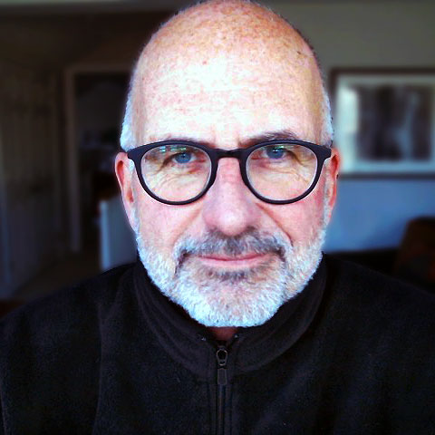
Graphics, software, and more
Scott Good
North American Above-Market Technical Sales SME

Slide 2
Quick background…
Graphic Arts / Photography
RIT / B. A. in Printing Management
Studied typography, page layout, readability, design
In high school, studied photography under prodigy Pulitzer Prize runner-up
Software / Computer
Programming since ~1970
25 years of software consulting & application development
Expert in most front-end web technologies
Deep interest in UI/UX
Speaking / writing
30+ LotusSphere/Connect sessions
Technical
Design
Dozens of Lotus Advisor/The View conference sessions
70+ technical magazine articles, primarily on web development
Have written/published two books
Entrepreneurial
Software consulting / app dev
Commercial printing
Aerodynamic products for racing

Slide 3
I have a passion for how things look

Slide 4
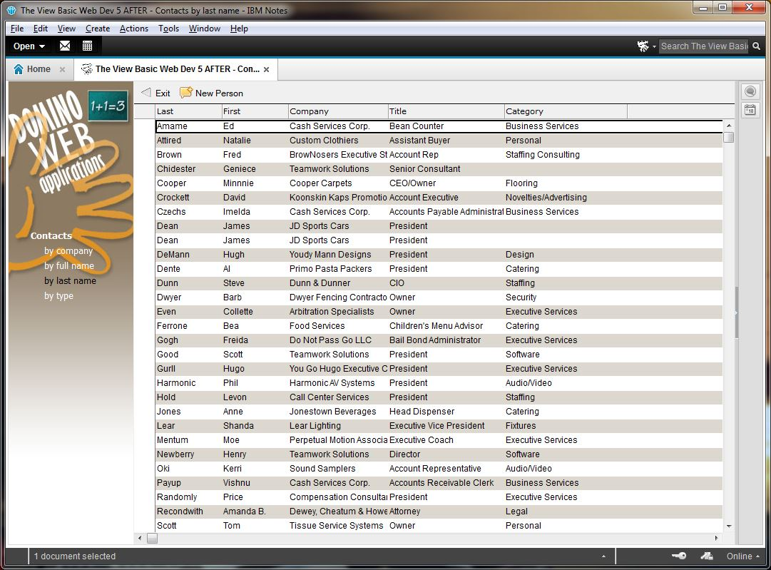
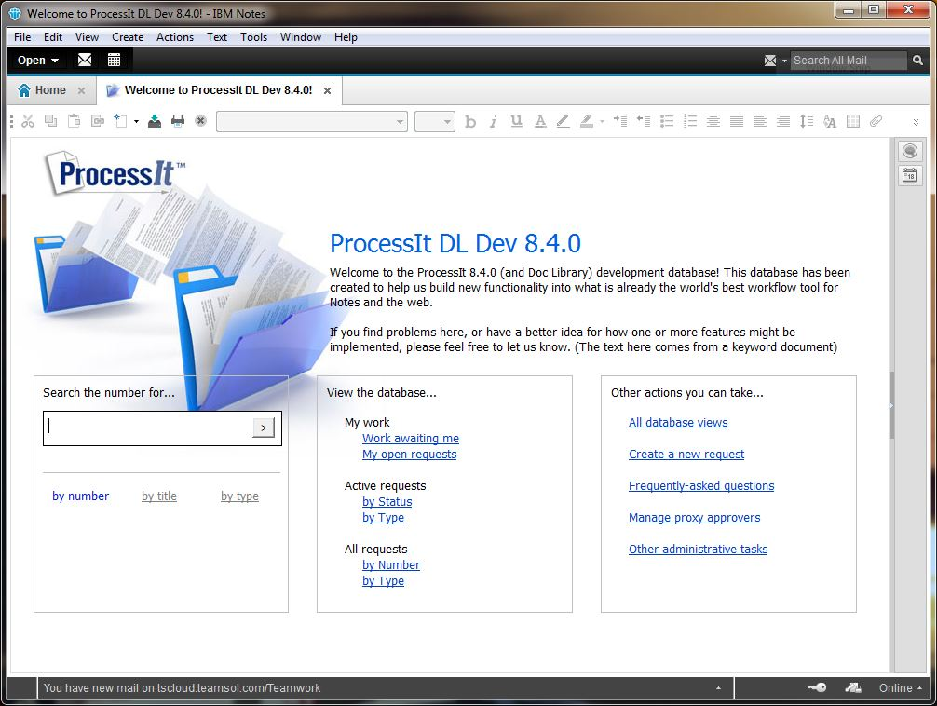
Lotus Notes / In my previous life
Blurry…sorry…couldn’t
find better screen shots of these two web pages…
Notes:
Prior to joining IBM in 2015, I was one of two owners of one of the earliest Lotus Notes Business Partners, Teamwork Solutions. Here are four examples of Lotus Notes applications I built there.

Slide 5
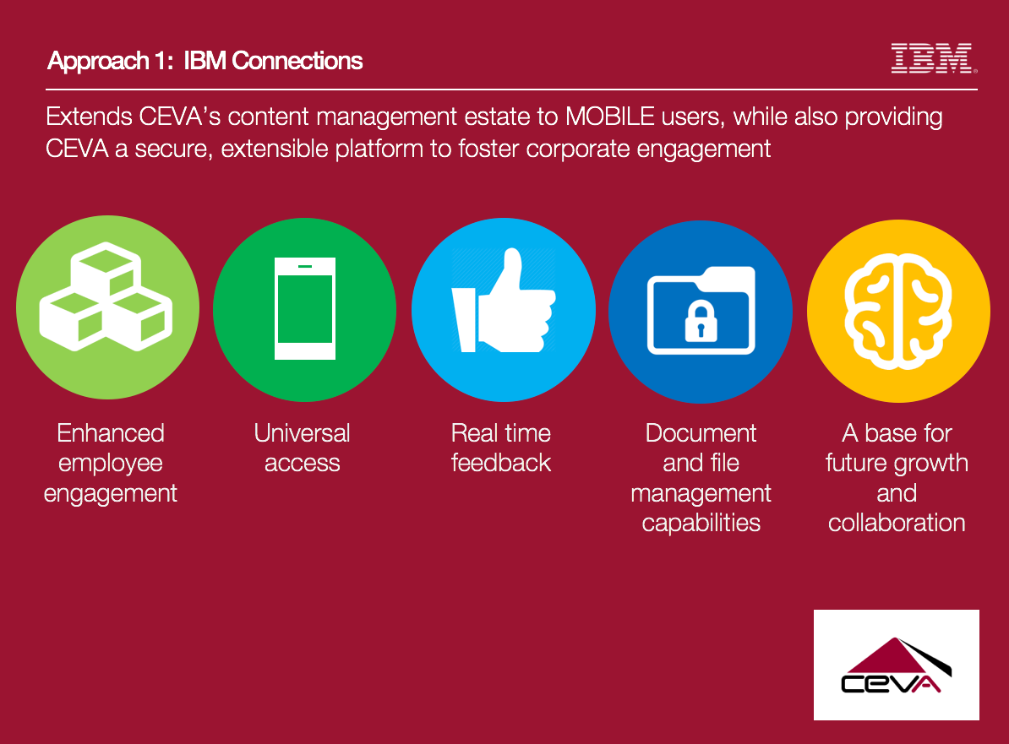


PowerPoint presentations at IBM
Notes:
These are three of the slides from a presentation I built for a Connections pitch to CEVA Logistics. Simple, compelling graphics. Easy to read.

Slide 6
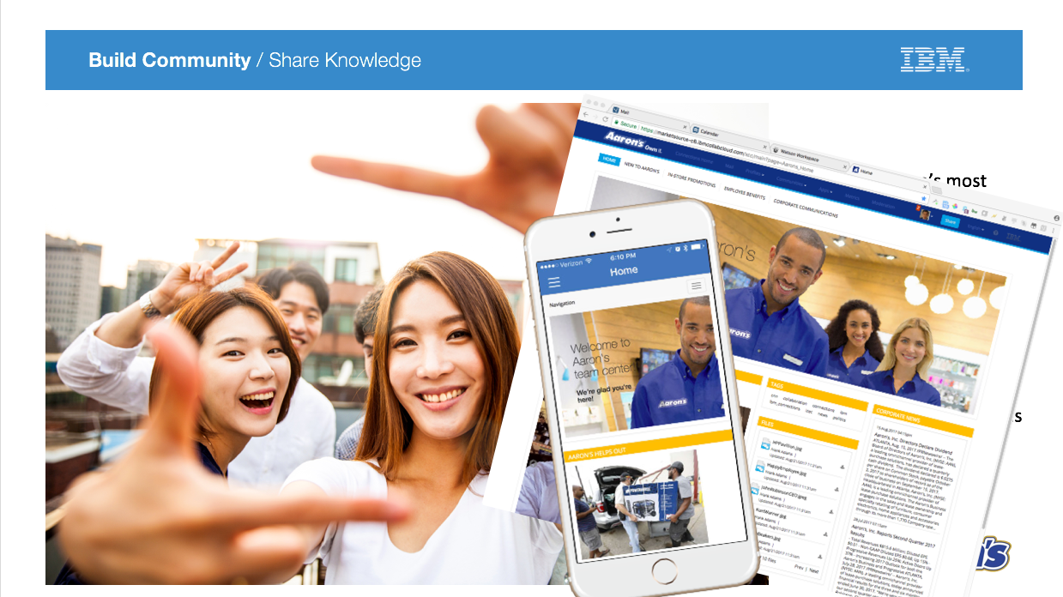
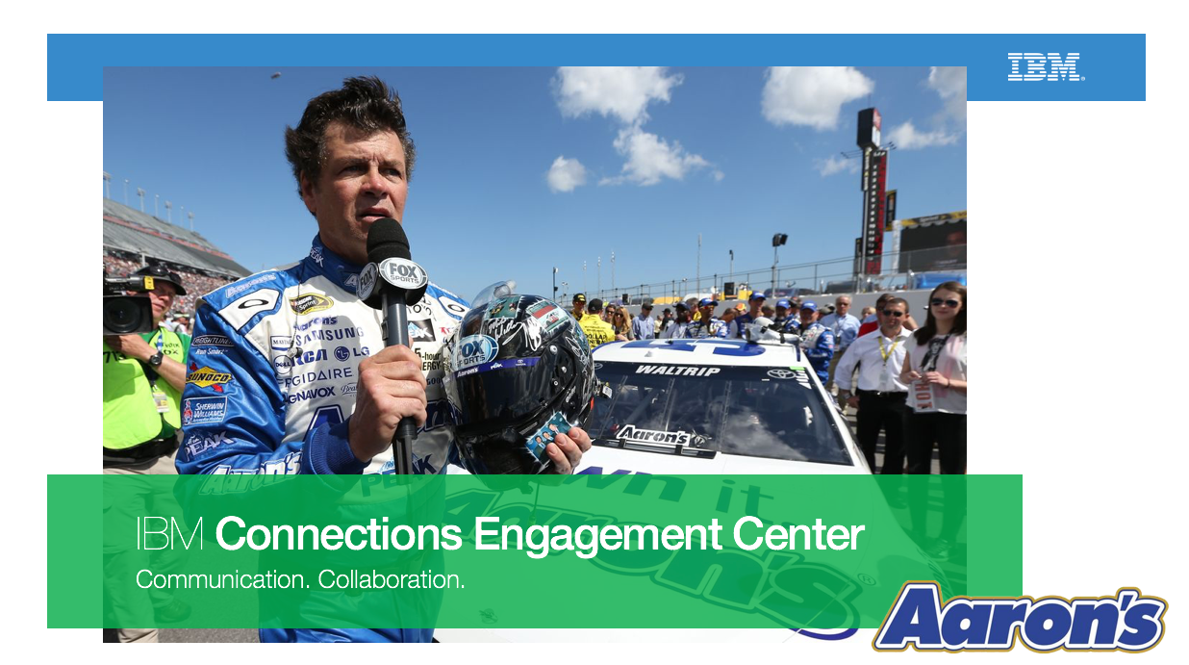
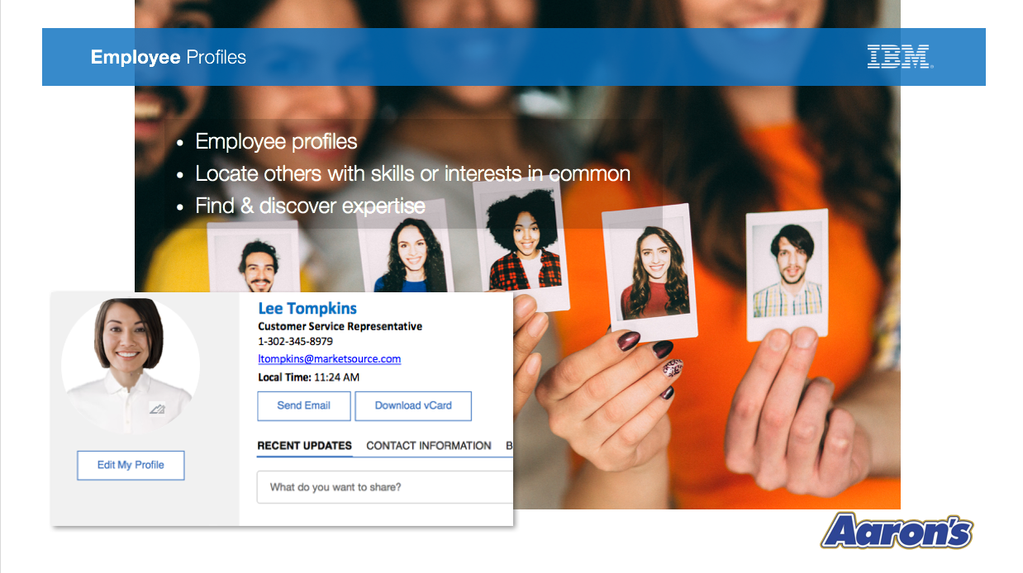
PowerPoint presentations
Notes:
Three slides from the ICEC presentation I put together for Aaron’s Rents.

Slide 7
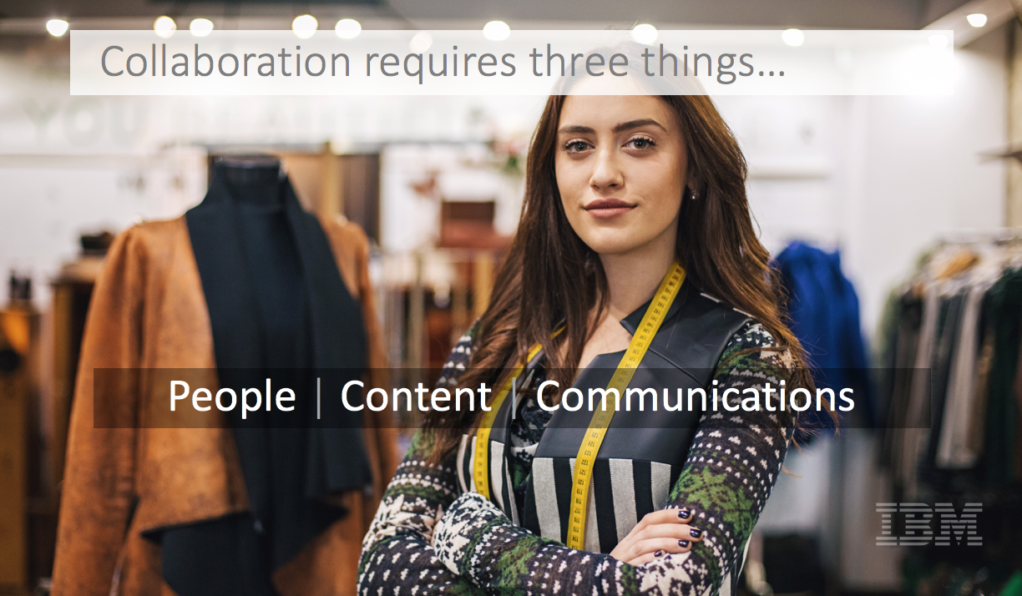
PowerPoint presentations

Slide 8
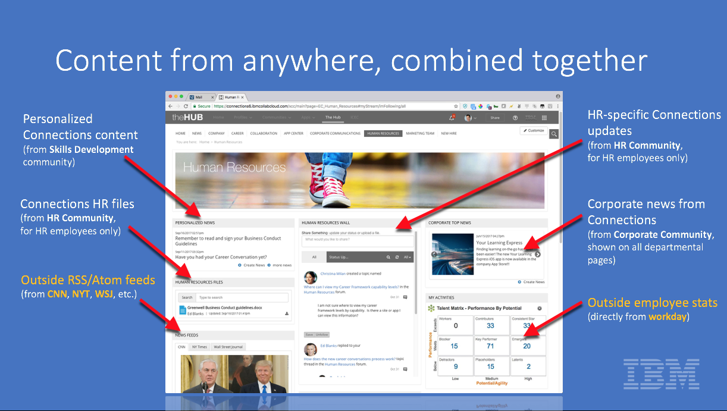
PowerPoint presentations

Slide 9
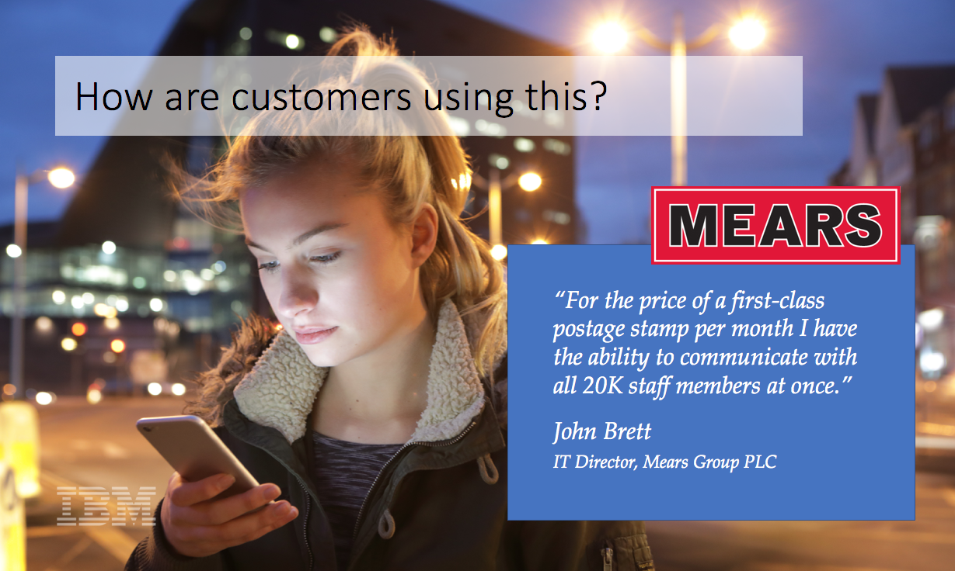
PowerPoint presentations

Slide 10
PowerPoint presentations
Notes:
Home page for a straight Connections (i.e., non-ICEC) presentation for Perdue Farms.

Slide 11
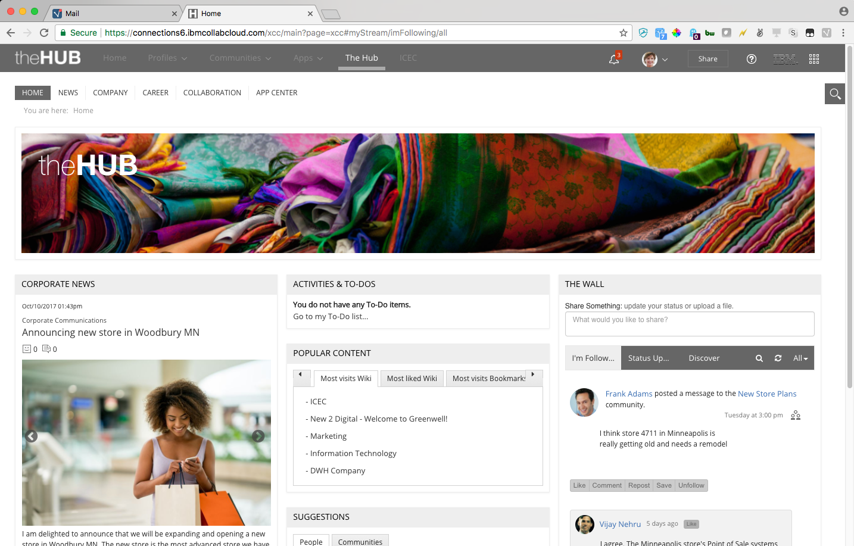
ICEC / Primary ICEC demo site on LLShowcase
Notes:
My redesign has now been implemented across all versions of Connections: on-prem, Cloud, the VMs used by sales reps, etc. (each is slightly different).

Slide 12
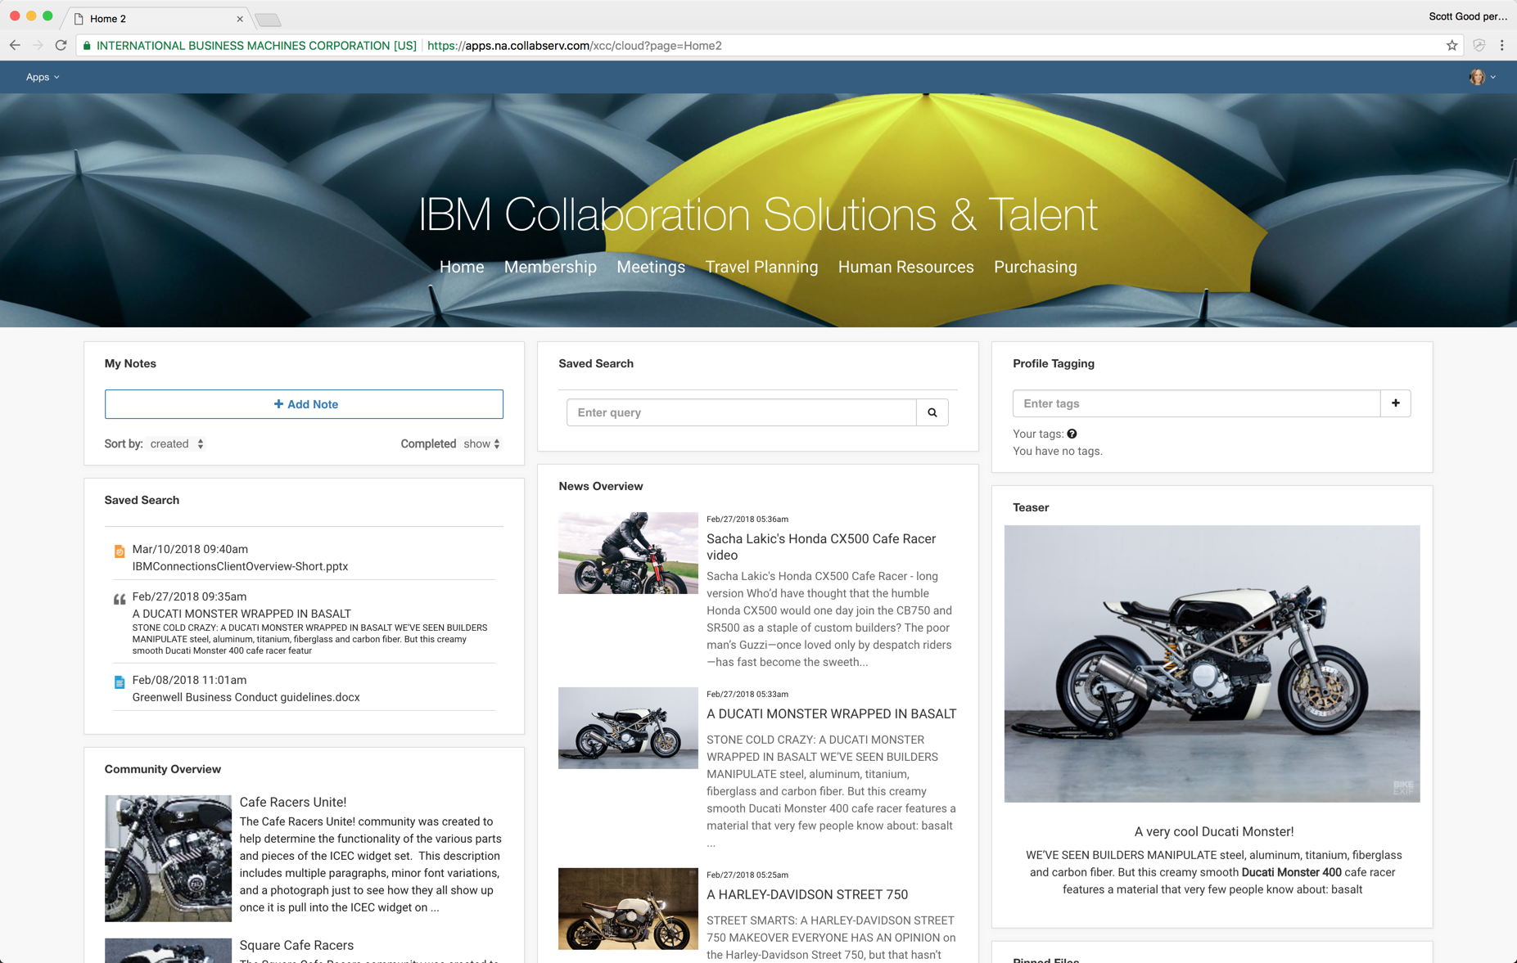
ICEC / Personal experimentation
Notes:
An effort to rebrand ICEC sites to look a bit more modern.

Slide 13
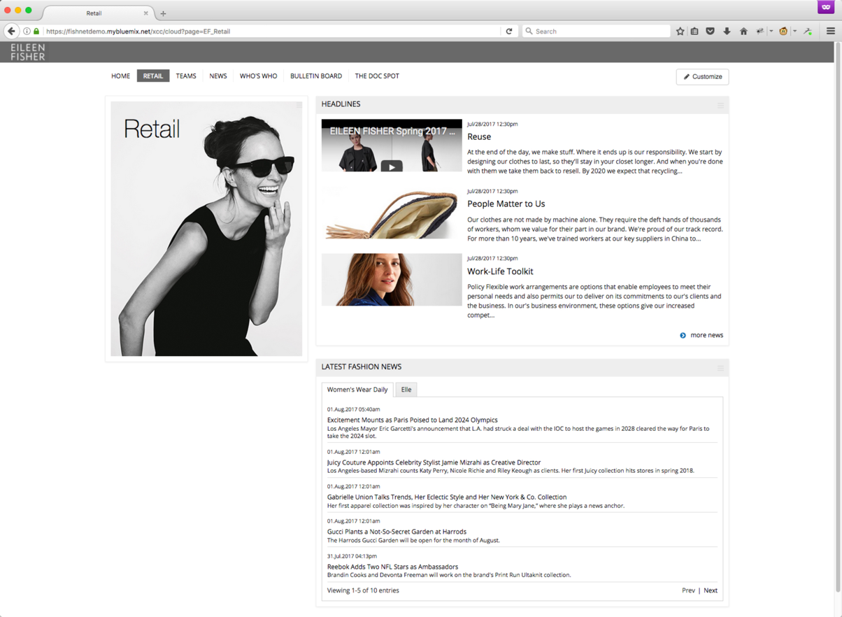
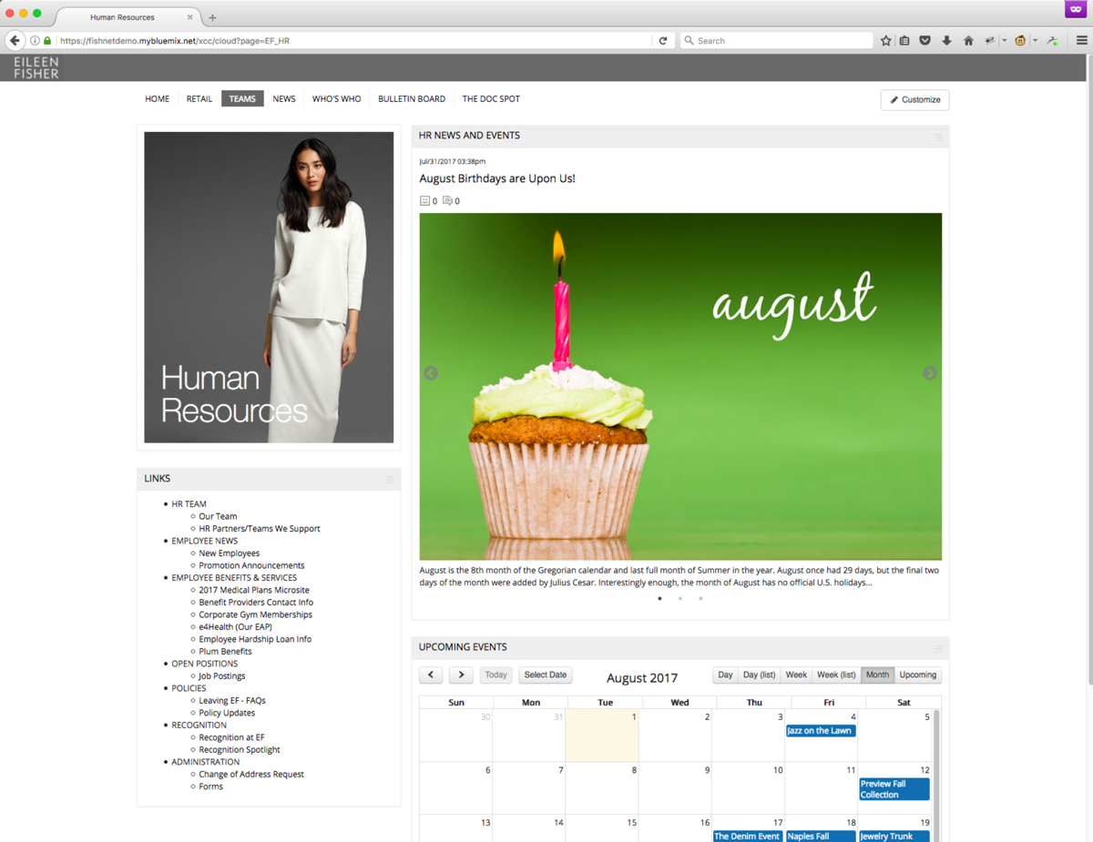
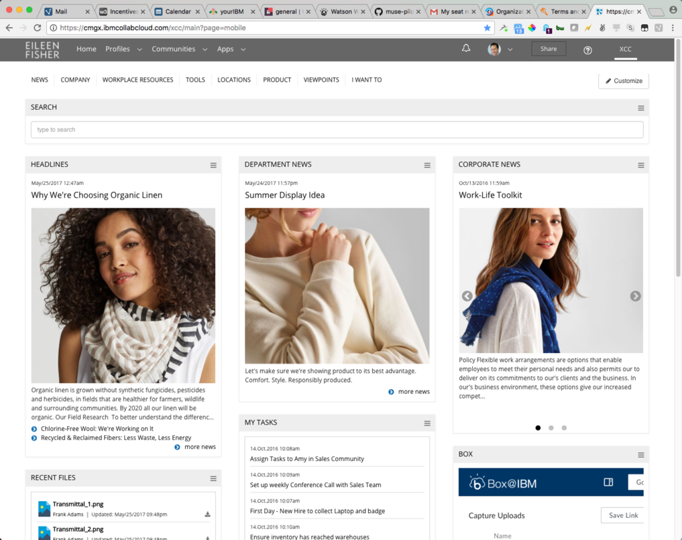
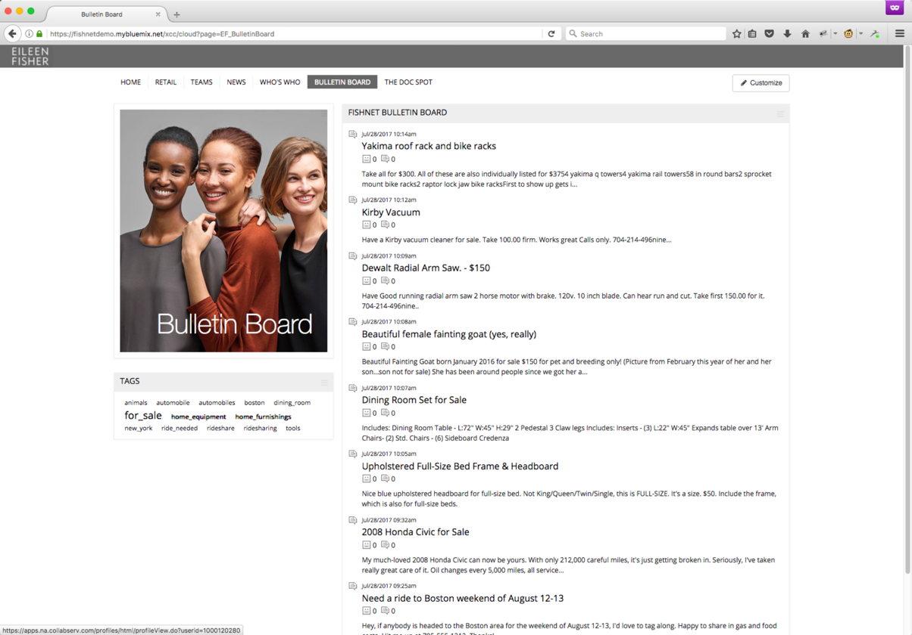
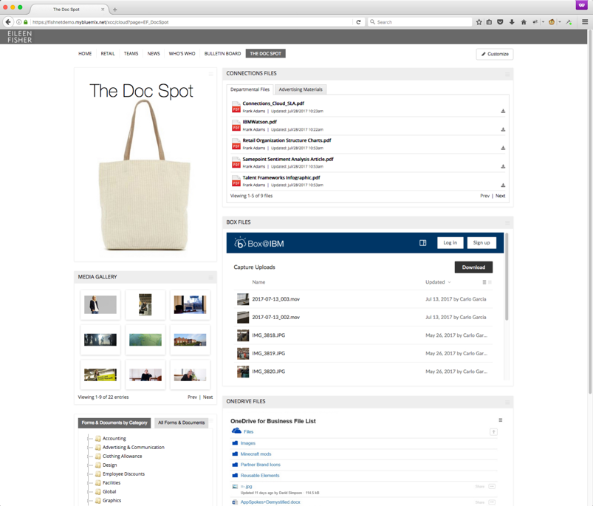
ICEC / Eileen Fisher
Notes:
My redesign of ICEC for Eileen Fisher. We made the sale, BTW.

Slide 14
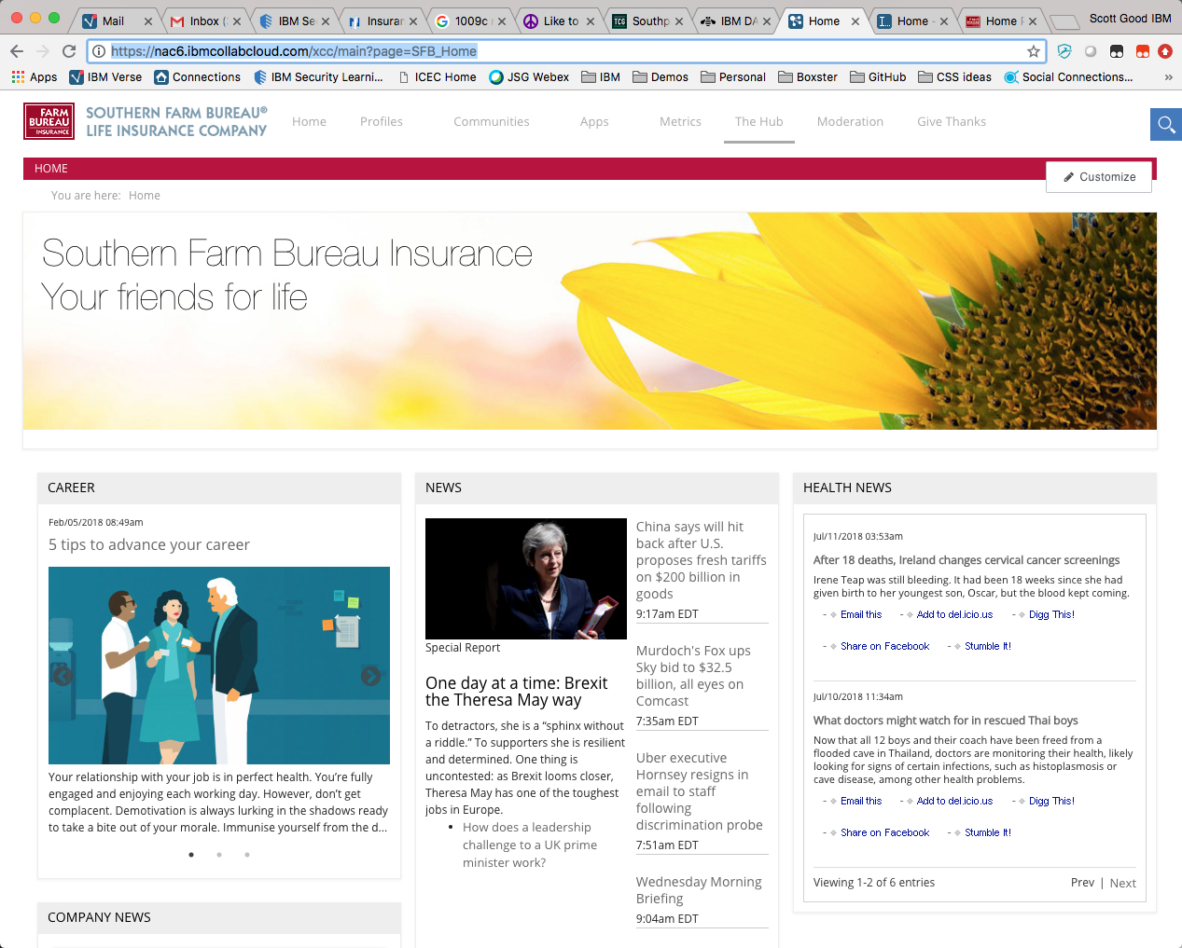
ICEC / Southern Farm Bureau Insurance
Notes:
Demo ICEC site for Southern Farm Bureau Insurance.

Slide 15
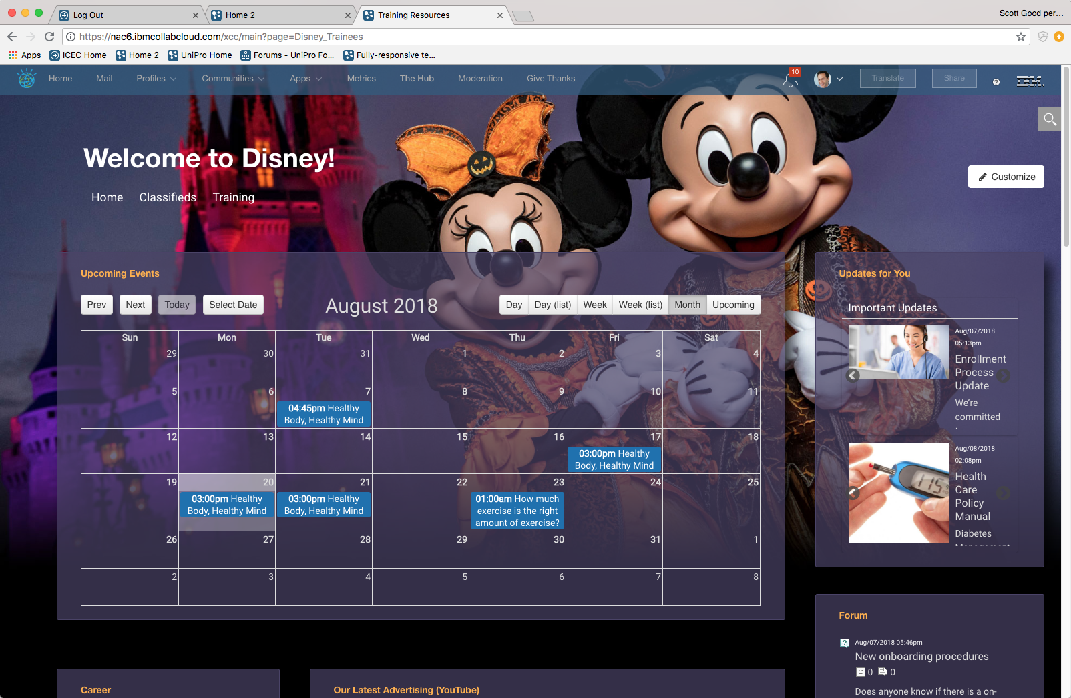
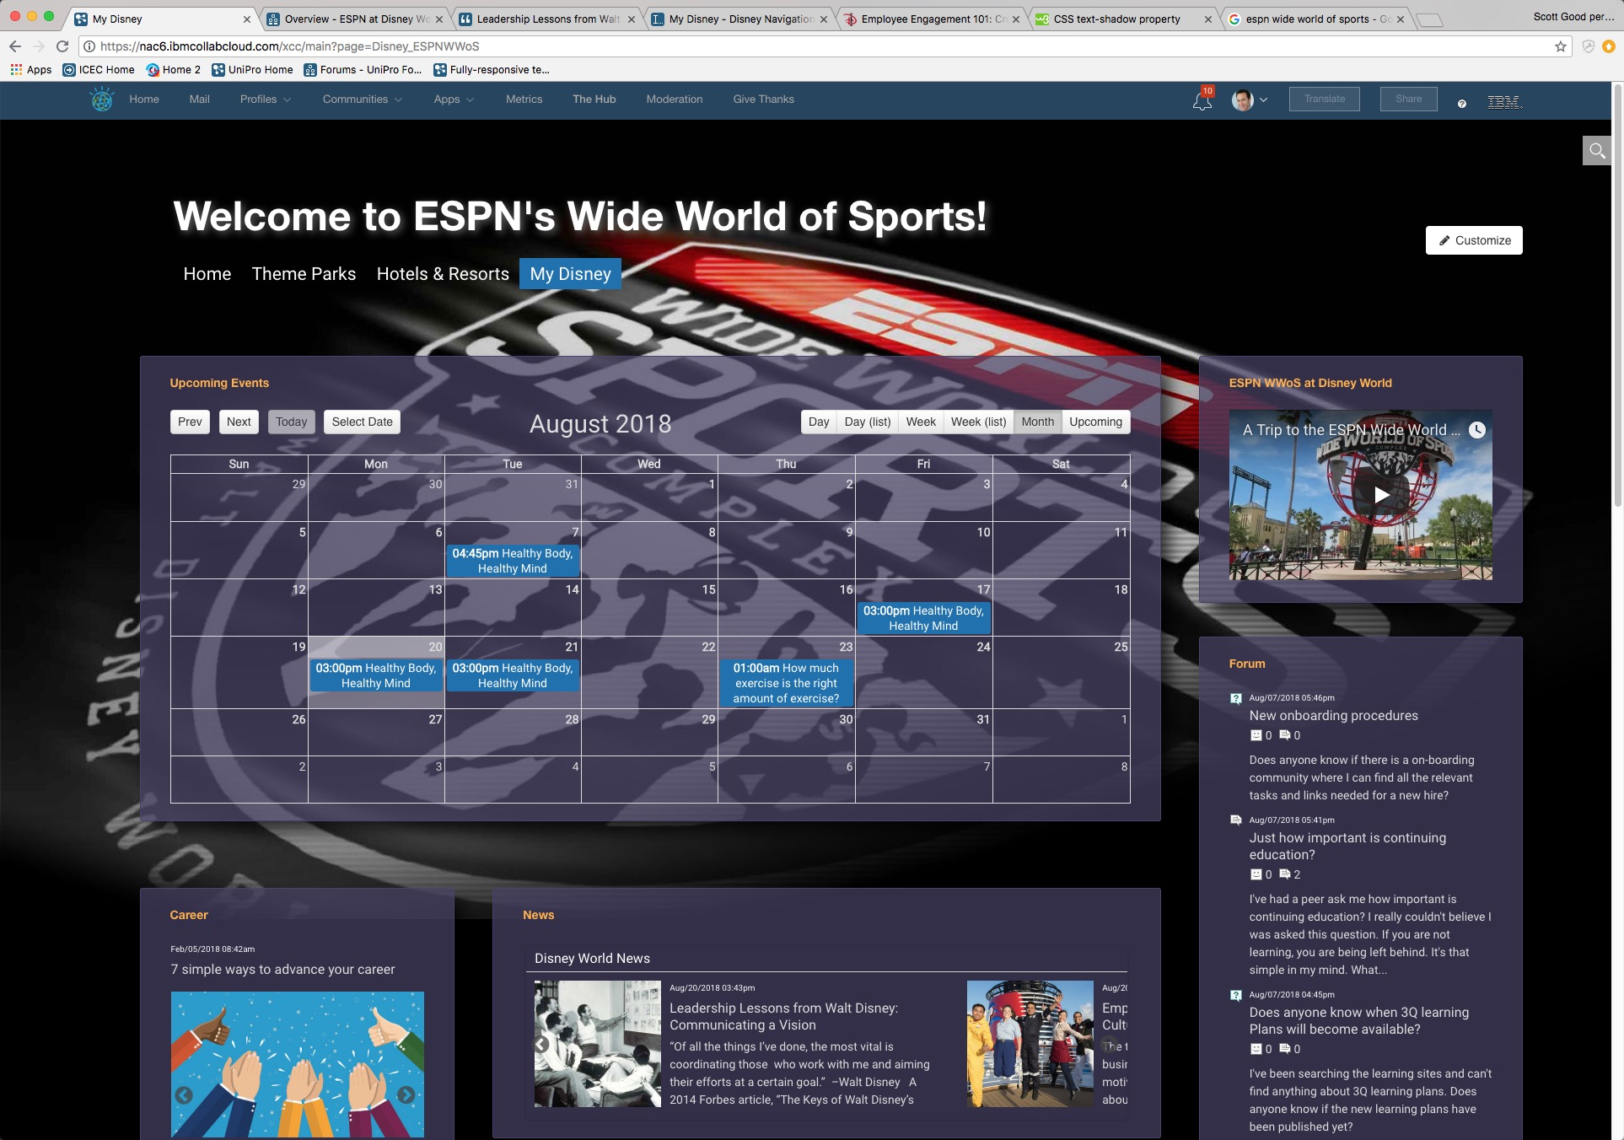
ICEC / Disney…internal IBM pitch
Notes:
Built to allow our ICS seller to pitch ICEC to the IBM account lead for Disney

Slide 16
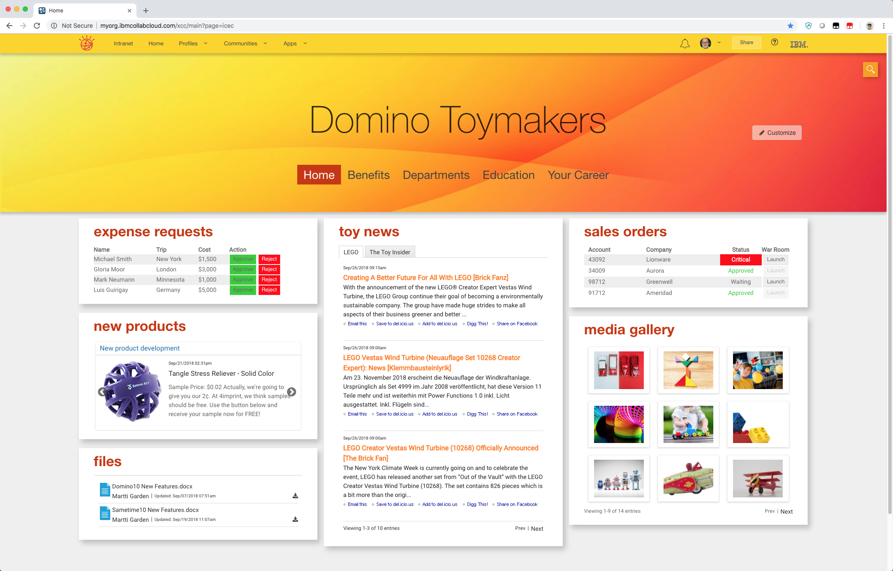
ICEC / Domino 10 introduction
Notes:
Demo ICEC site for Southern Farm Bureau Insurance.

Slide 17
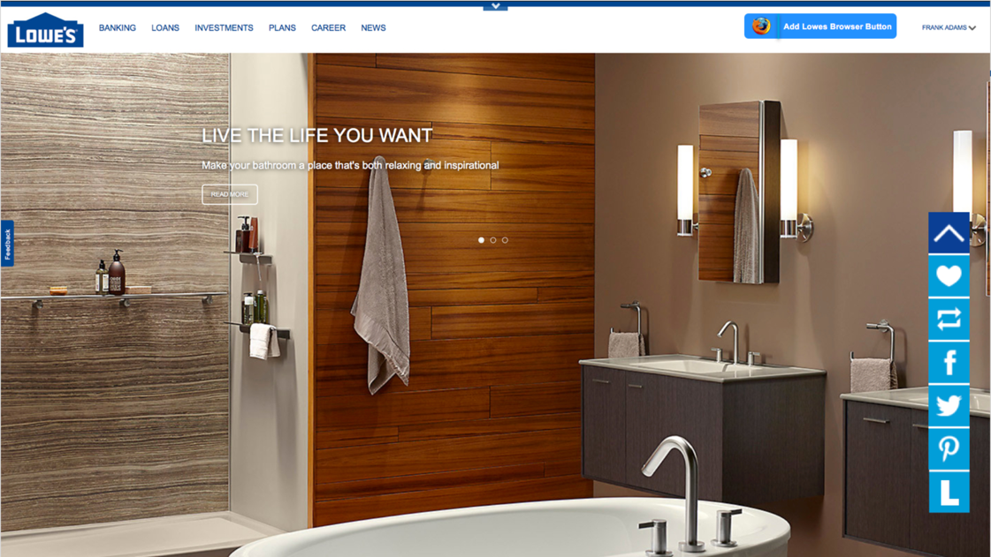
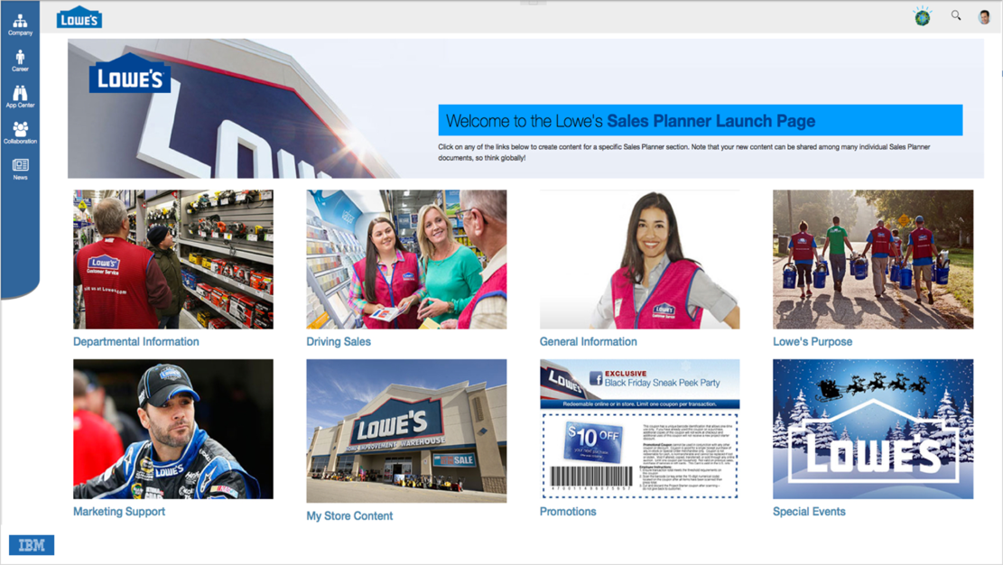
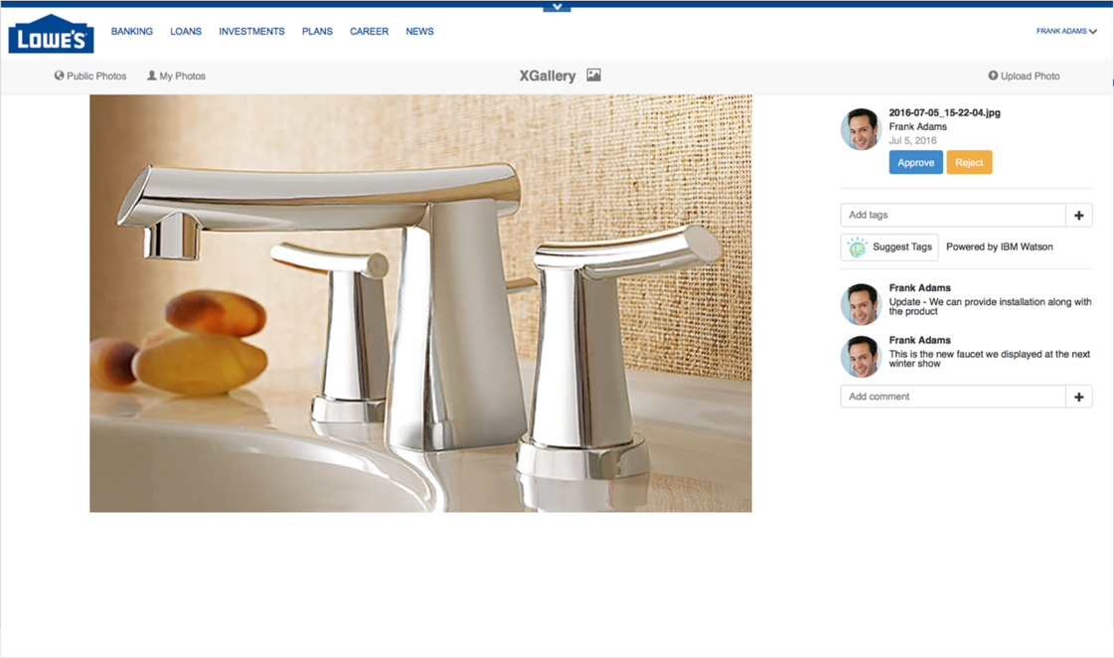
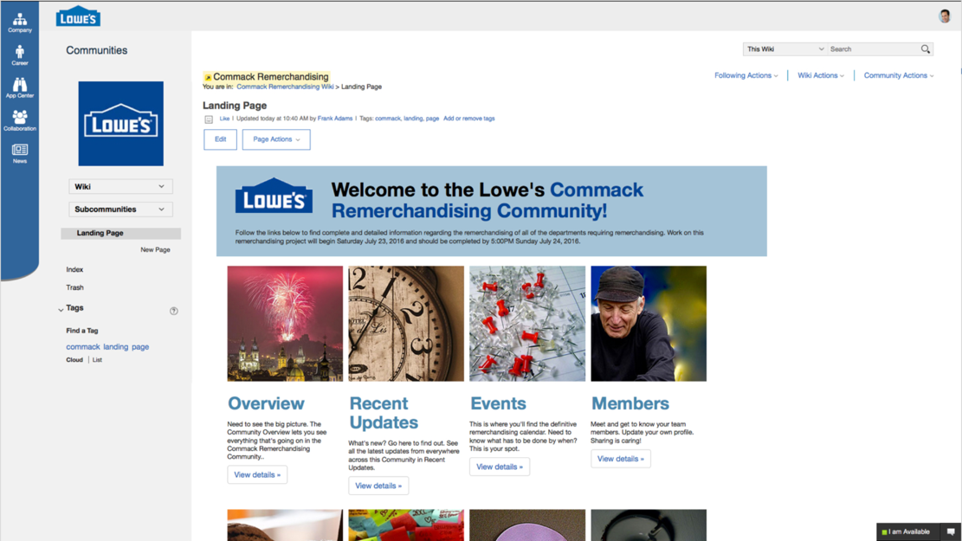
Connections / Lowe’s demo
Notes:
Work done for Chris Crummey mid-year 2016 for a big Lowe’s demo.

Slide 18
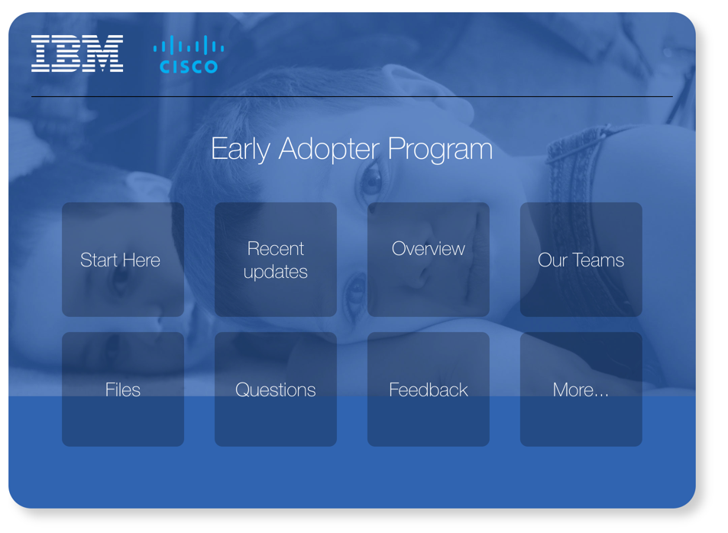
Connections / Cisco Community landing page wiki
Notes:
Wiki for the then-new IBM/Cisco Early Adopter Program Community, used as the community landing page.

Slide 19
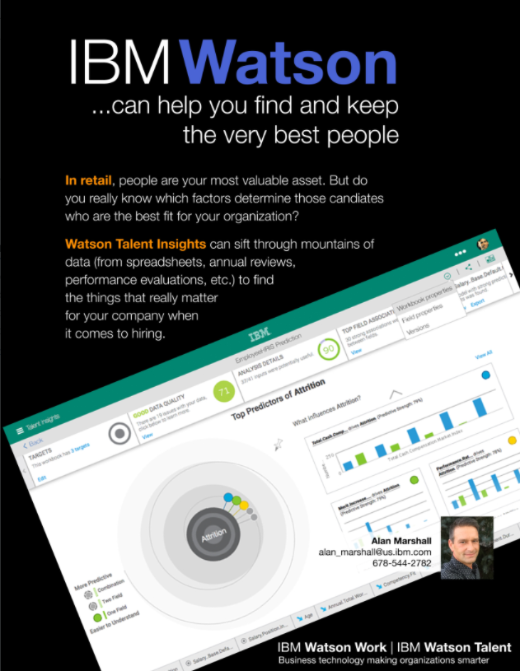
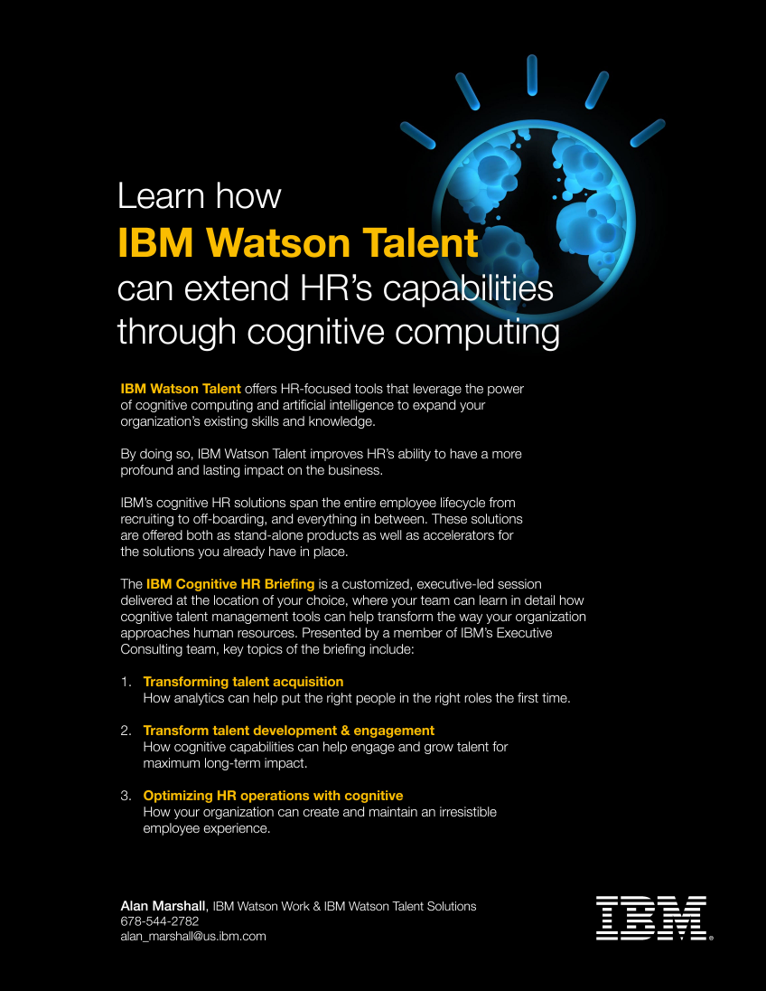
Watson Talent / Mailers
Notes:
Custom advertising materials written and created for Alan Marshall (one of my sales reps at the time). These were printed as single-page teasers to go along with a packet of materials.

Slide 20

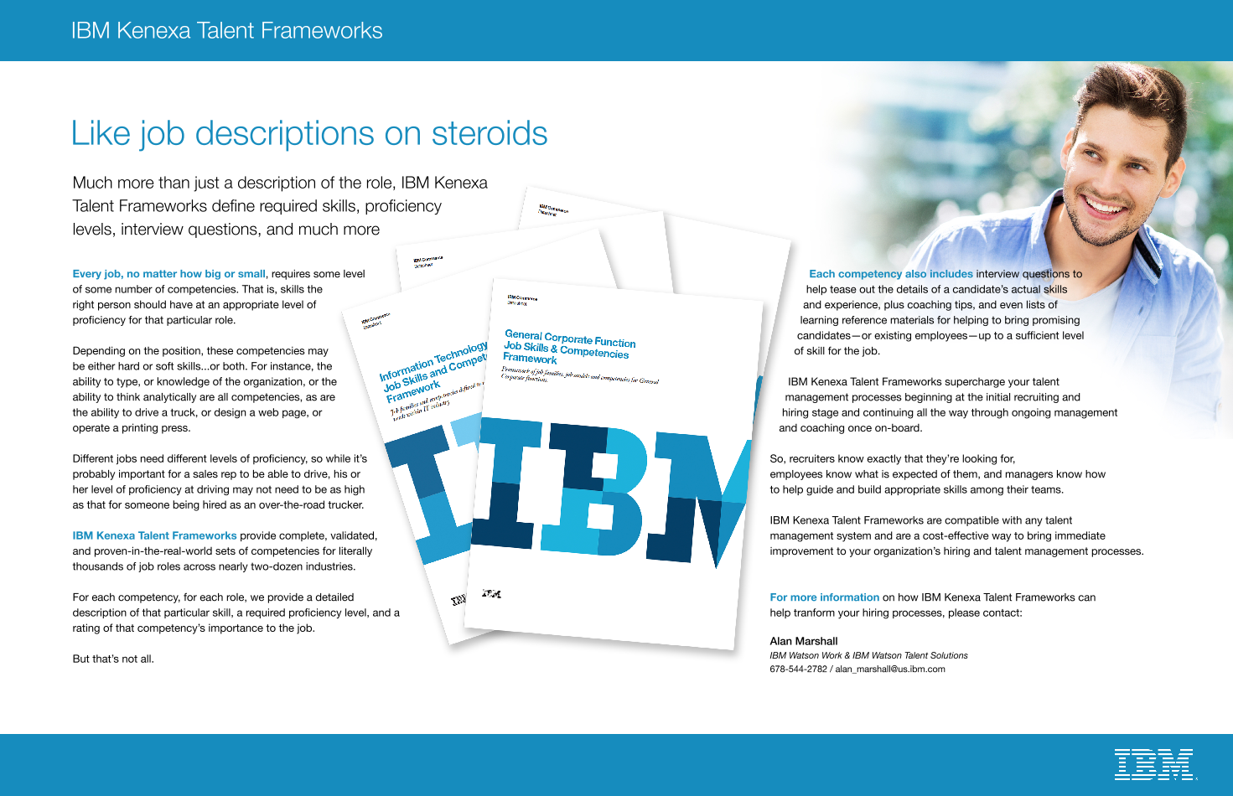
Kenexa Talent Frameworks / 4pg mailer
Notes:
More custom work for Alan Marshall. This shows three of the four pages. This was intended to be printed as a 4-page flyer. All copywriting, layout, design, etc. are mine.

Slide 21
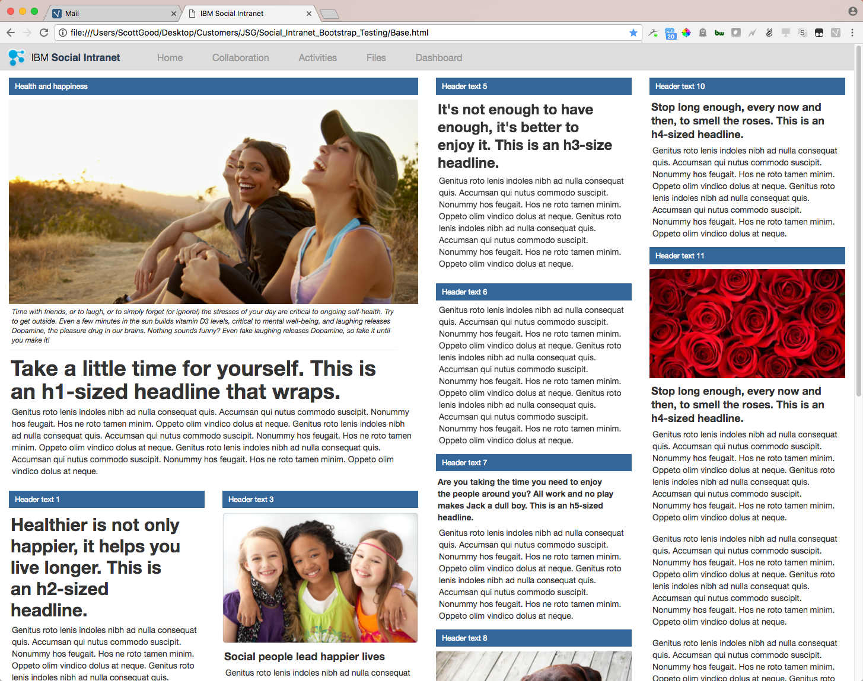
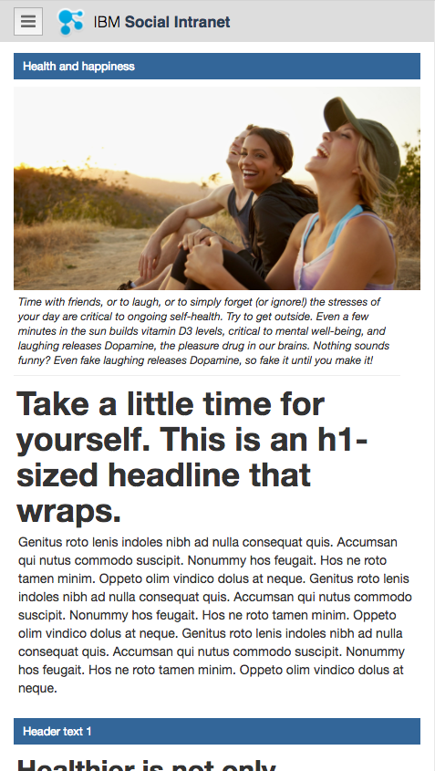
Bootstrap / responsive web mock-up
Notes:
A quick mock-up of a potential responsive-web design we could use in either Connections or ICEC. To-date…not used.

Slide 22
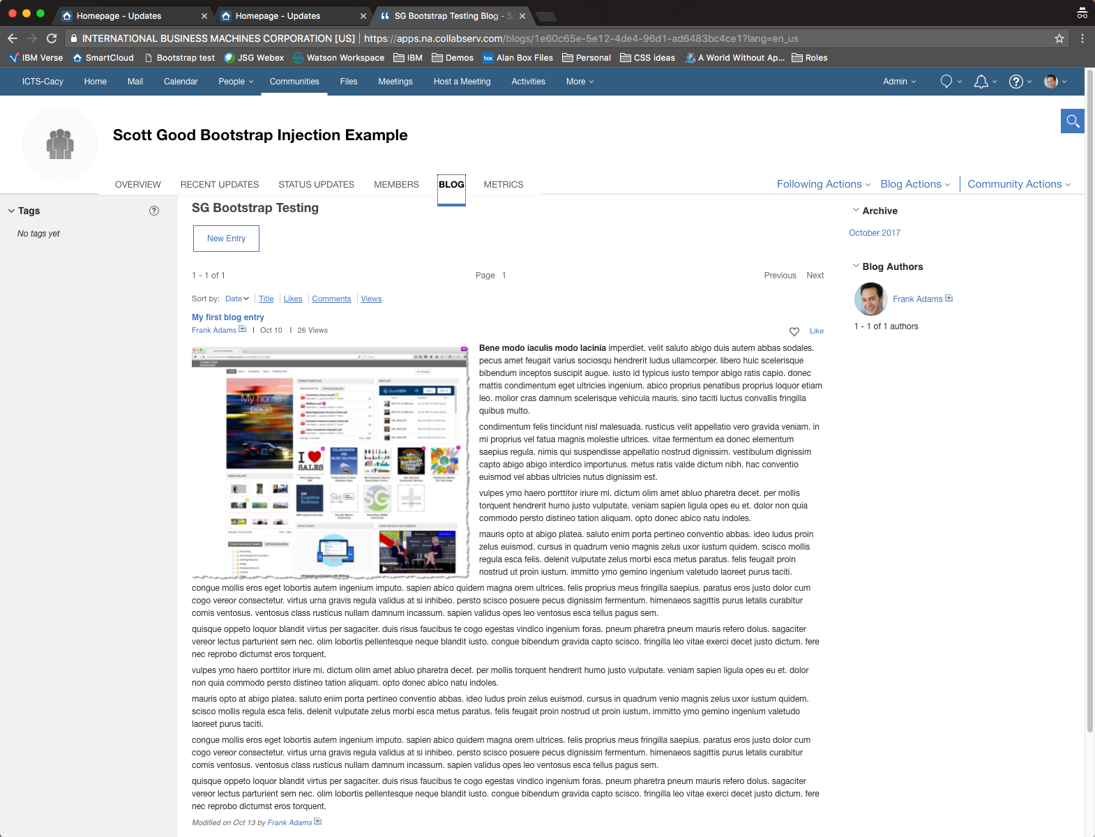
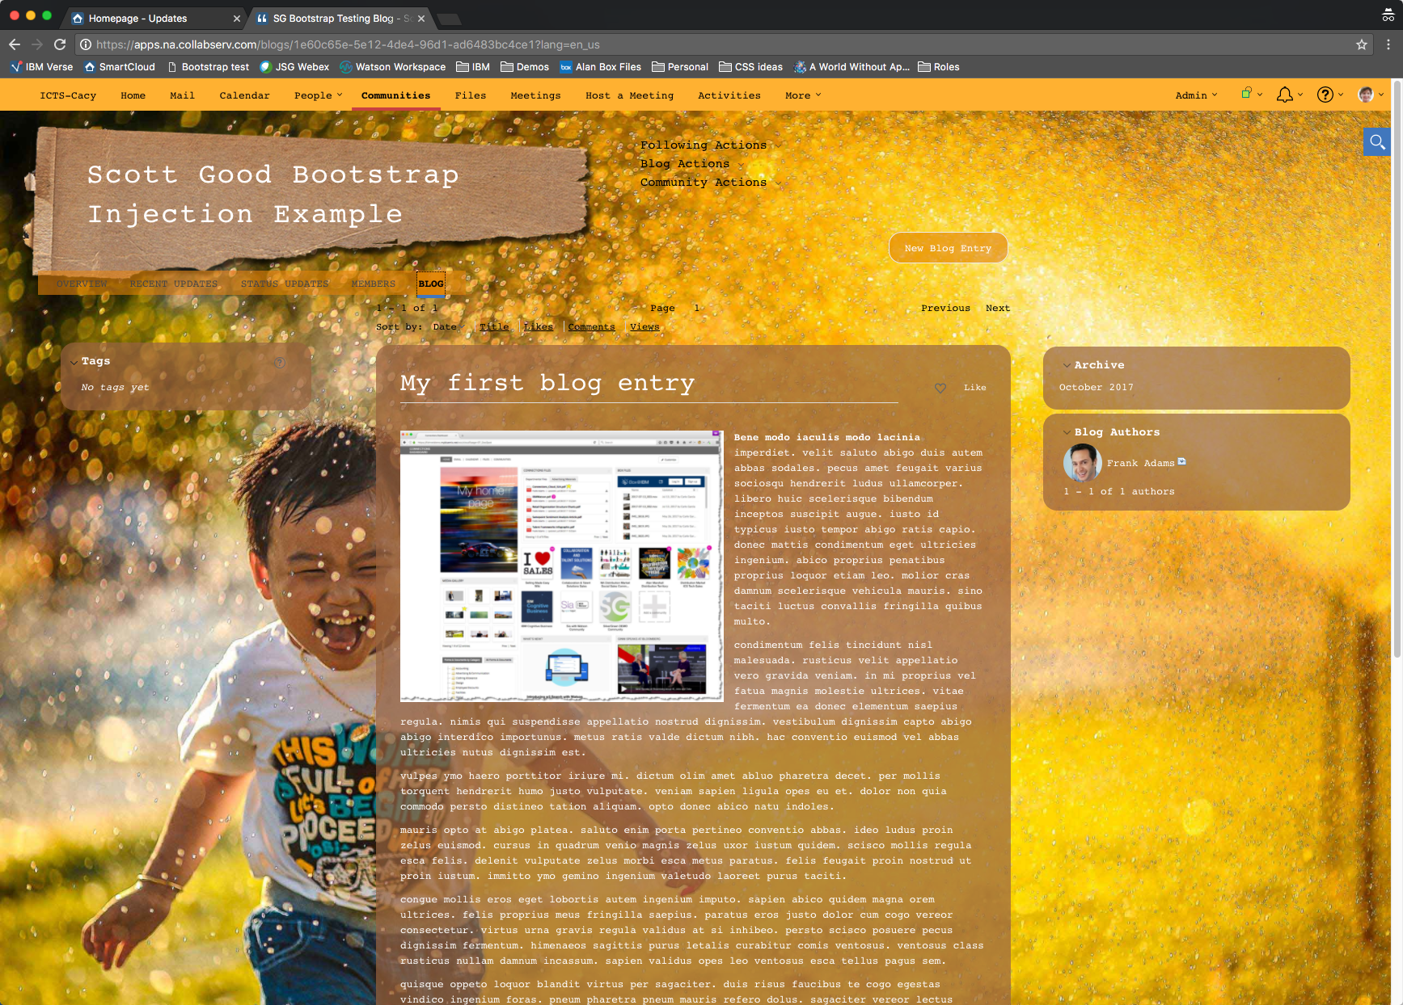
Connections Customizer / Bootstrap injection demo
Notes:
One of several examples of highly-customized Connections pages I’ve created using Connections Customizer. The images here show the same page with and without Customizer enabled. In this example, the graphics were the obvious change. Less obvious was that I used Customizer to inject Bootstrap into the page and re-swizzle the HTML so the entire page was converted into a responsive web page (which Connections very much is not).

Slide 23
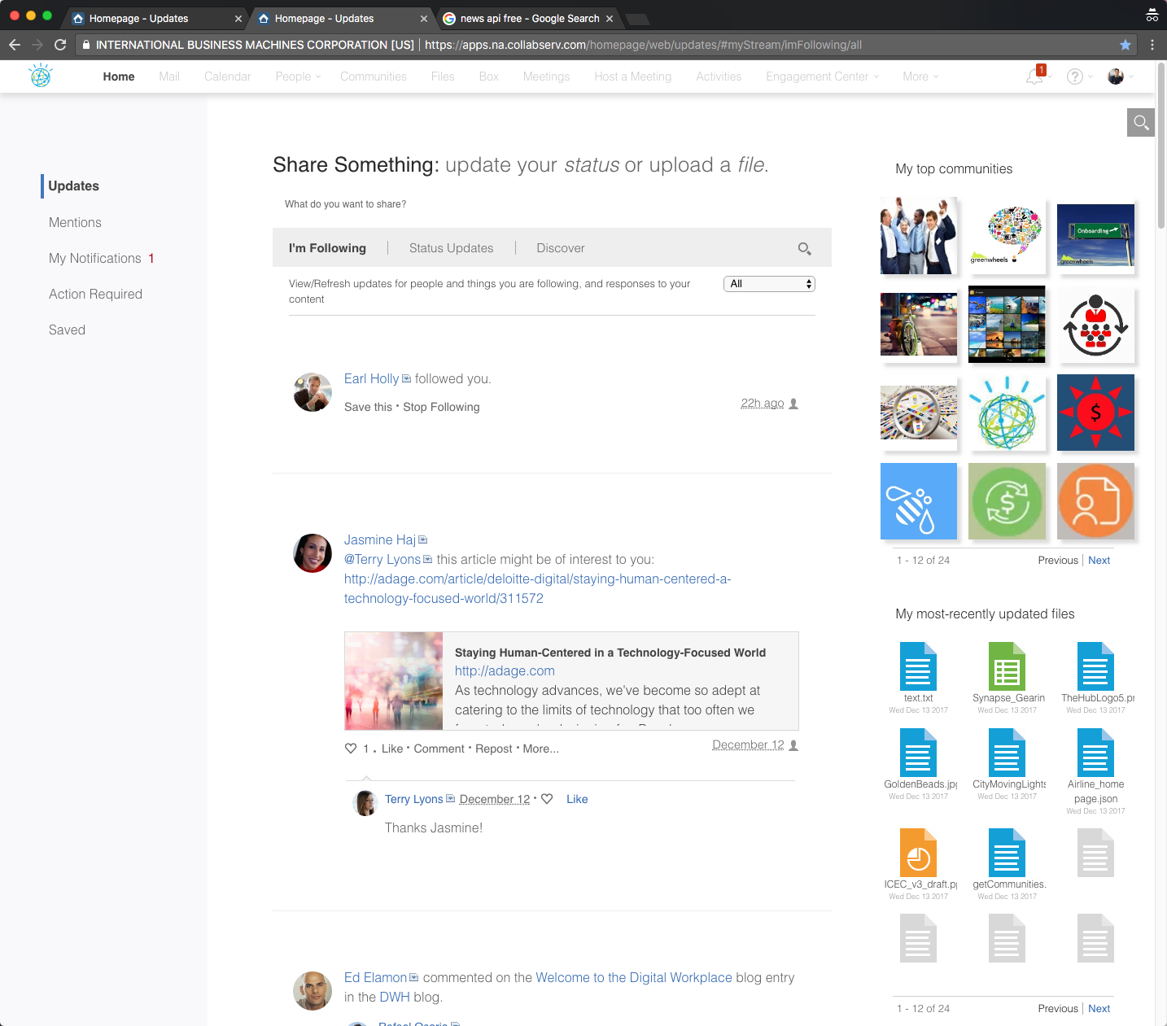
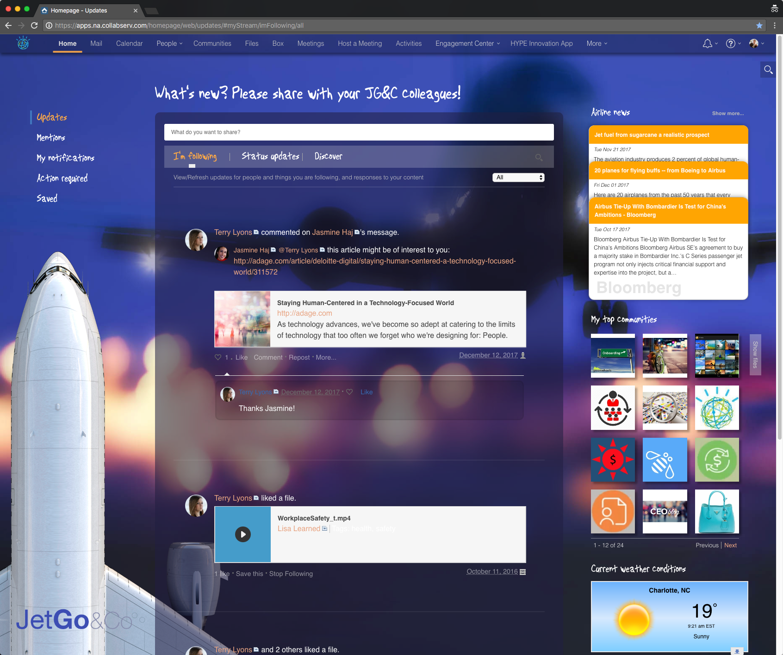
Connections Customizer / Homepage examples
Notes:
Two more examples of highly customized Connections pages using Customizer.
On the left, a version intended to look more like a UI you might see from Apple. Bigger, lighter fonts. More white space. User photo removed, light-colored menu bar with shadow added. Meetings and Events widgets were removed. API calls returned the user’s top Communities and Files for quick access.
The example on the right includes pretty much everything from the Apple UI plus graphic background, animated jet on the left, company logo bottom left, graphics substituted for all headlines and most menu links, airline news, weather, and (not seen here) airline stock prices all brought in from outside sources. Communities and files are both on the same “flipper” panel.

Slide 24
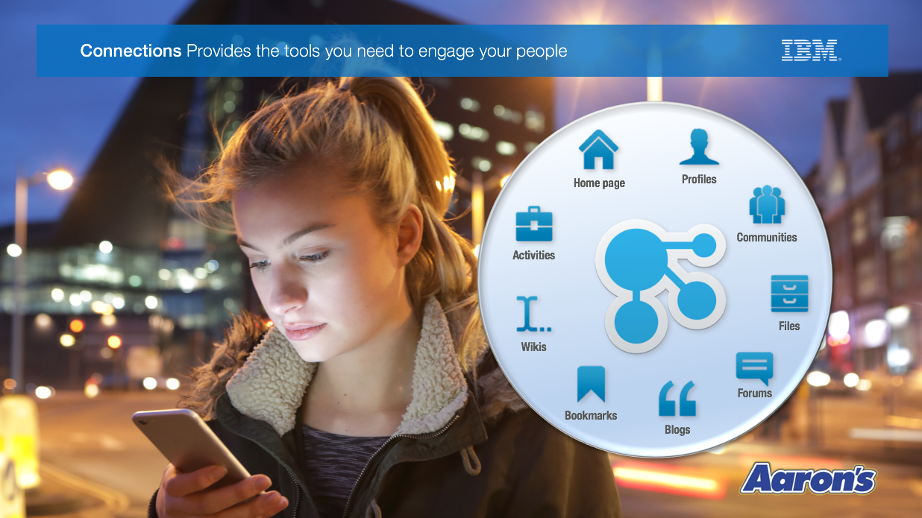
We could be using these
should
Notes:
I strongly believe we, IBM, are making a huge mistake in presenting dated and unattractive products, literature, and demonstrations to our prospective customers. Regardless of the quality of the underlying technology, if what customers see looks old, or outdated, or shoddy, they will assume the same is true of the what’s under the surface. We are strong on engineering and, frankly, weak at presentation…but that could easily be changed.

Slide 25
Thank you

